Slide 1
SI100B Project: RoboWriter
Lecture : Introducion
Weibang Bai
2025 Fall @ SIST

Slide 2
Outline
Introduction
Project Overview
Lecture Overview
Grading Creteria

Slide 3
Introduction
Robotics is the interdisciplinary study and practice of the design, construction, operation, and use of robots.
Robotics usually combines three aspects of design work to create robot systems:
Mechanical Aspect: A frame, form or shape designed to achieve a particular task.
Electrical Apsect: Components that power and control the machinery.
Software Aspect: A program is how a robot decides when or how to do something.
By NASA - http://marsrovers.jpl.nasa.gov/gallery/press/opportunity/20120117a.html, Public Domain, https://commons.wikimedia.org/w/index.php?curid=18160707

Slide 4
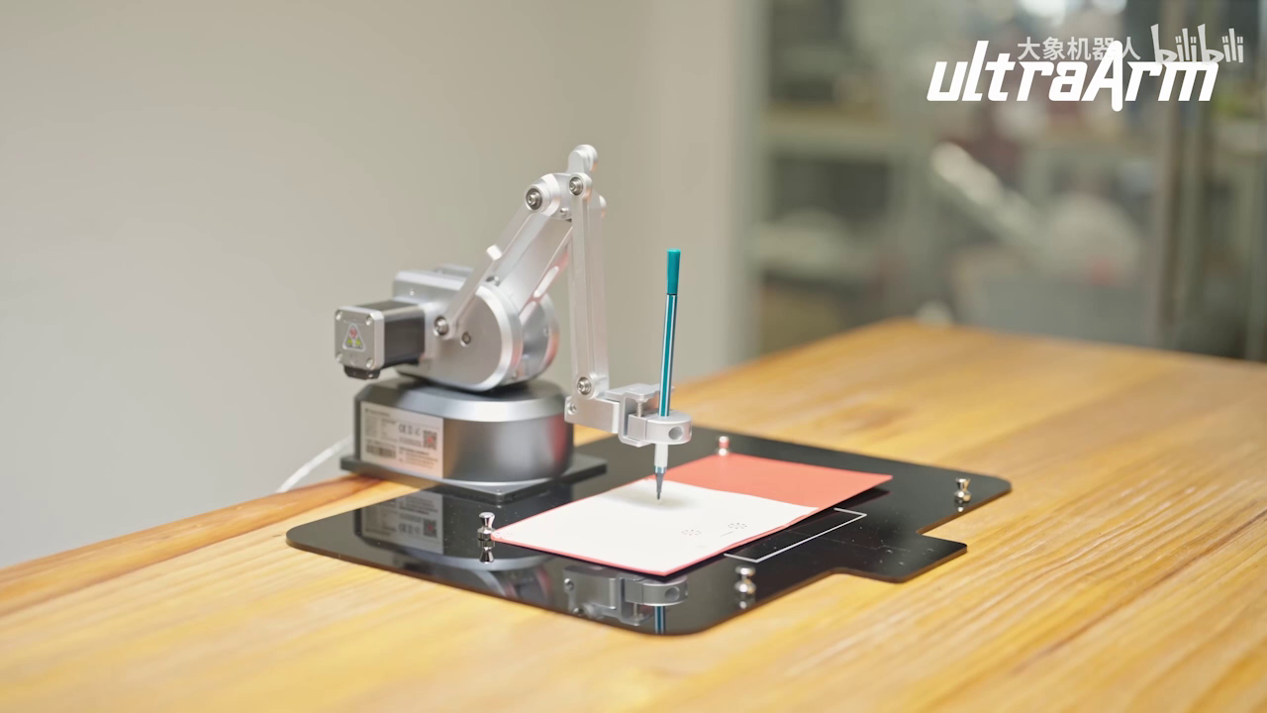
Project Overview
RoboWriter: Using programming languages such as Python to control virtual simulation robots and perform the writing of specified font characters like names, student IDs, etc.
If any students want to test on real robots, they can also use the lab's robotic arm platforms UR3, Franka, OpenArm, and several smaller robotic arms.
https://www.bilibili.com/video/BV1B84y1Y78i

Slide 5
Project Overview
RoboWriter: In this project, instead of ineracting with real robot directly, you will play with a simulated robotic arm in MuJoCo, a general purpose physics engine developed by Google DeepMind.
Needs Video Here

Slide 6



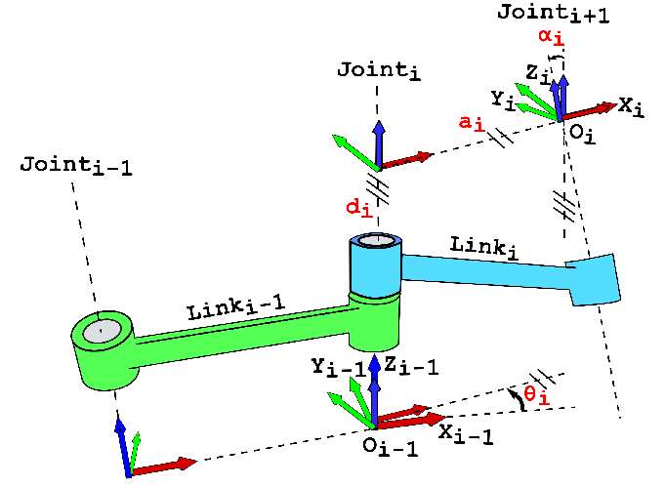
Lecture Overview
Stage 1: Environment Setup & Basic Operation
Stage2: Transfermation
By Pushpendra050 - Own work, CC BY-SA 4.0, https://commons.wikimedia.org/w/index.php?curid=87693685

Slide 7
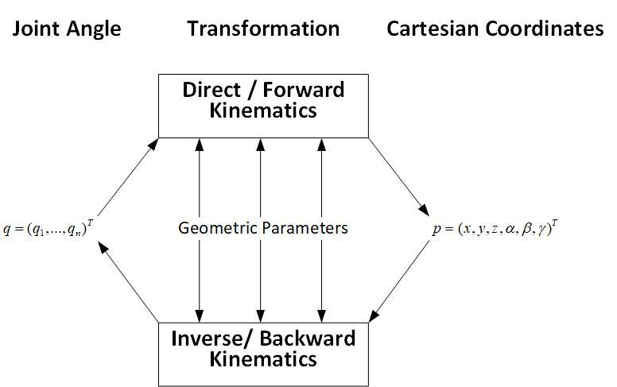
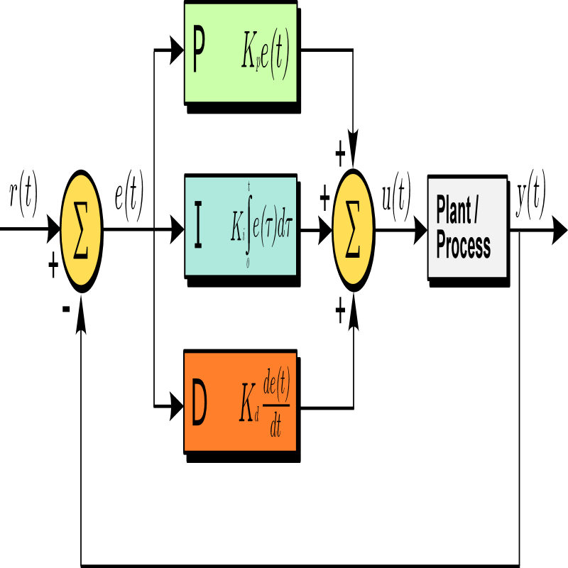
Lecture Overview
Stage 3: Kinematics
Stage 4: Motion Planning
By Haendy-freak - Own work, CC BY-SA 4.0, https://commons.wikimedia.org/w/index.php?curid=86278722
Stage 5: Basic Control Strategy
By Arturo Urquizo - File:PID.svg, CC BY-SA 3.0, https://commons.wikimedia.org/w/index.php?curid=17633925

Slide 8

Lecture Overview
Stage 6: Project working & Report writing
Stage 7: Project Presentation

Slide 9
Grading Creteria
Parctice 1-4: 5% each, 20% total
Project Report: 50%
Project Presentation: 20%
Project demo video: 10%
Bounus: TBD

Slide 10


谢谢 Thanks ！

